Slide 1
Tutorial 1 Learning Topology Optimization Through Examples and Case Studies
August 18, 2019

Slide 2
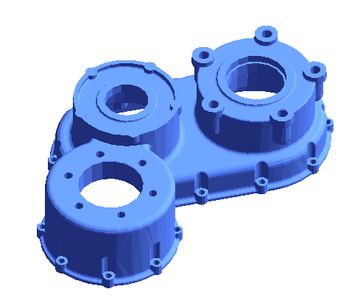
FEA with Pareto
Gear Box_Left
Normal force (100N)
Units: MKS
Material: AlloySteel
Structural Loads: 1000N
Mesh Size: 1 million elements
Fixed Bottom
Carry out a Static Structural FEA for the Gear Box_Left

Slide 3
Results_Stress

Slide 4
Results_Displacement

